Slide 1
Network Programming
Linux Epoll
Framework/RCV: Garen Huang
2019/11/01

Slide 2
List
Daemon
Signal
Endian
File description
I/O model
I/O Multiplexing
Epoll
Reactor model & Coroutine
Q&A

Slide 3
Daemon
Child process detach to background from terminal.
Take over the child process with the init process.
Clear file group permissions limit on child processes.
Close Child process association to terminal.
STDIN_FILENO
STDOUT_FILENO
STDERR_FILENO

Slide 4
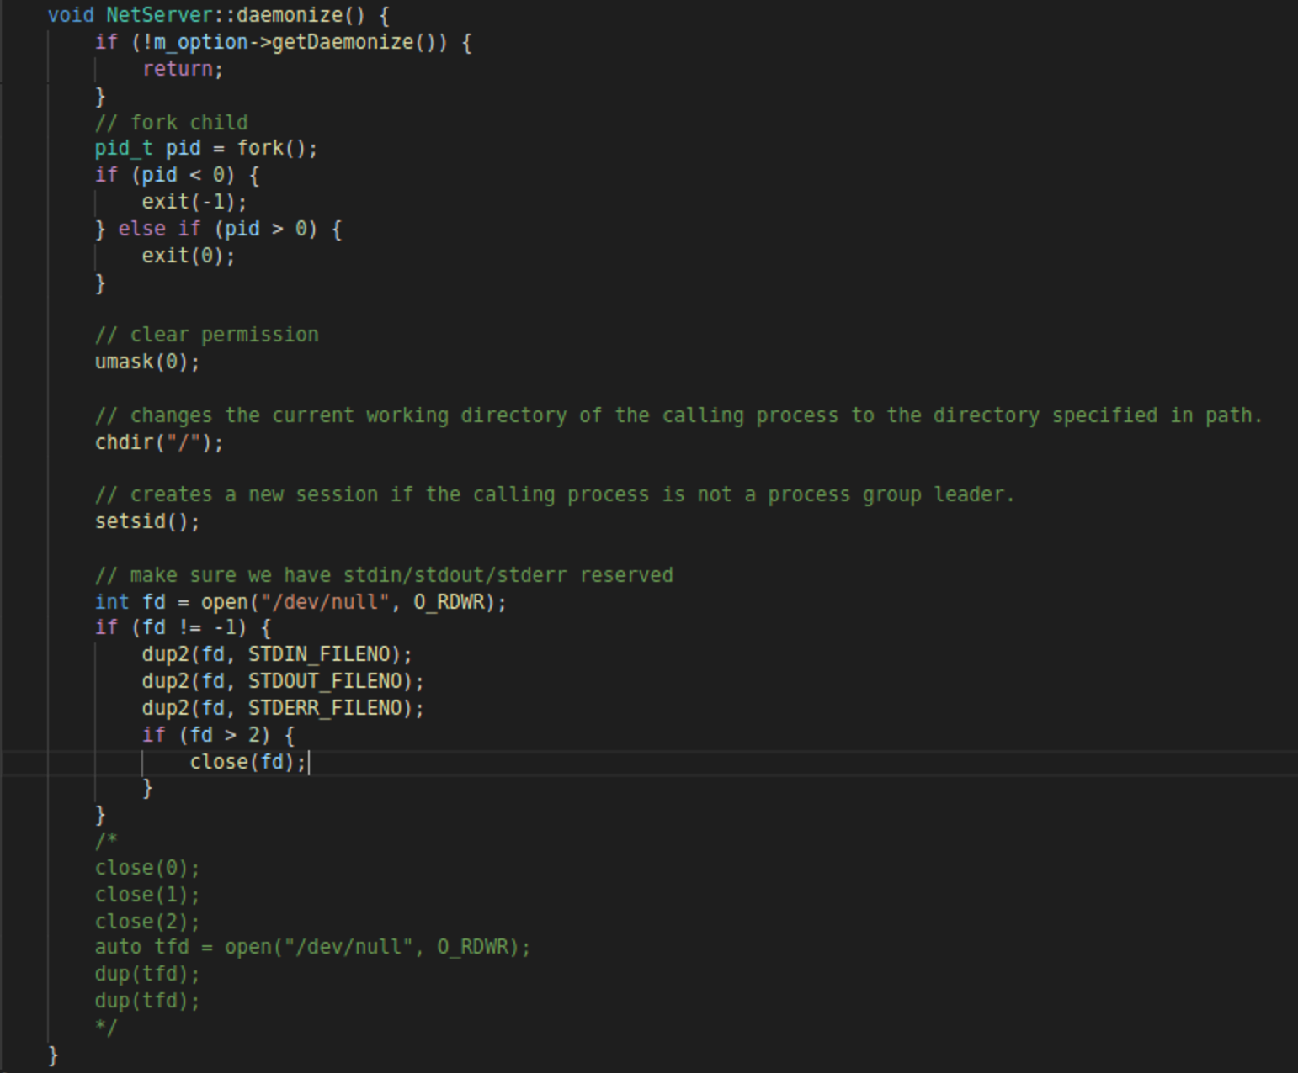
Daemon

Slide 5
Signal
Ignore interference
Ignore exit signal from fd(pip, socket)
Ignore signal from terminal
Elegant exit
Monitor exit signals from the system(kill command).
Performance improvement

Slide 6
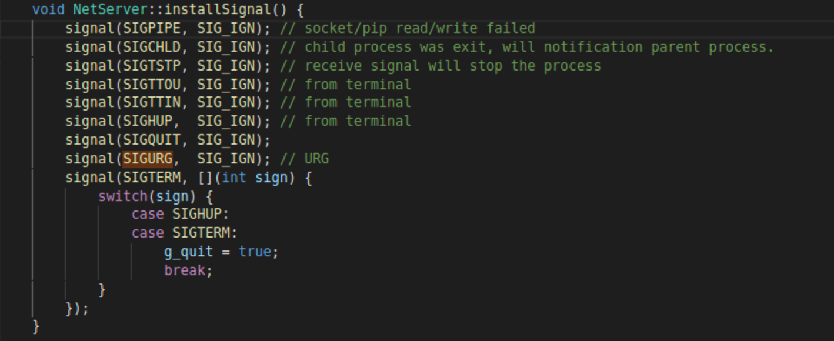
Signal

Slide 7
Endian
Little Endian and Big Endian are two ways of storing multi-byte data-types in computers.
Big Endian
First byte of binary representation of the multi-byte data-type is stored first
Little Endian
Last byte of binary representation of the multi-byte data-type is stored first

Slide 8
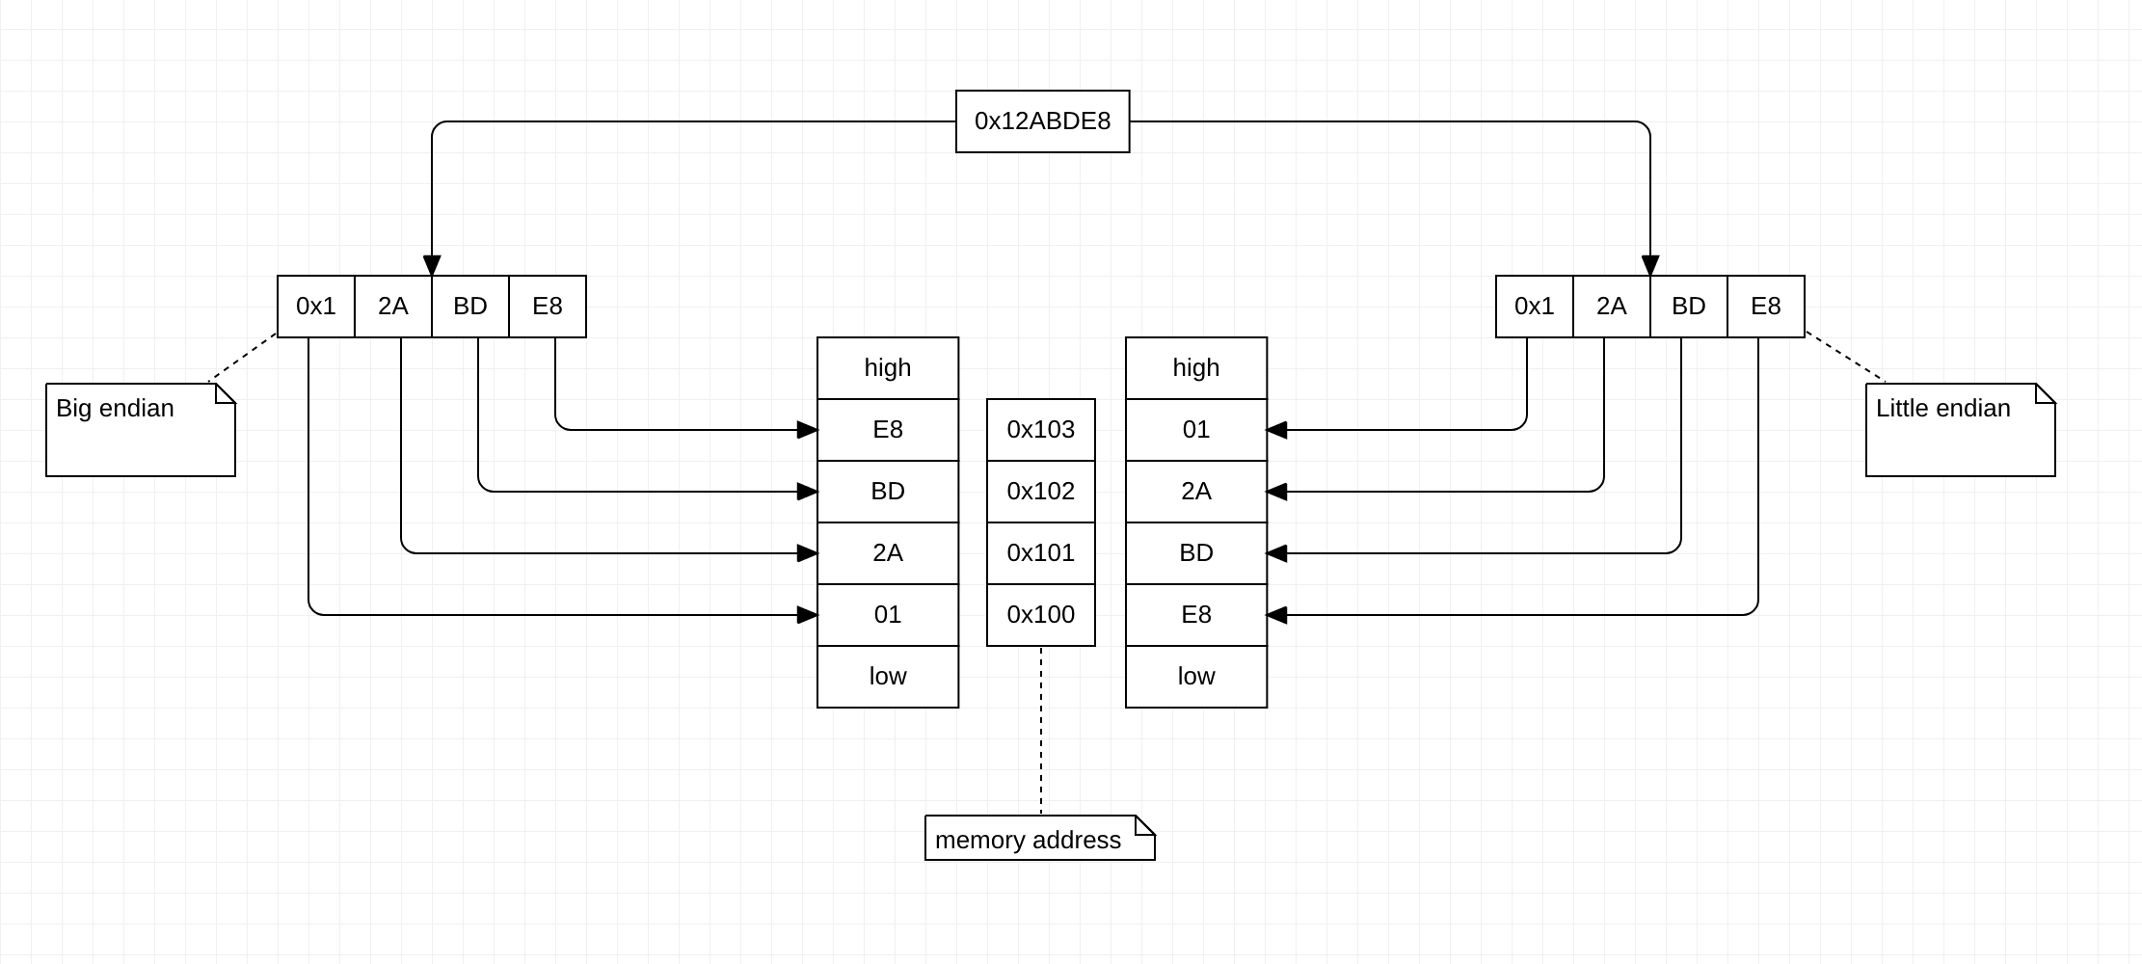
Endian

Slide 9
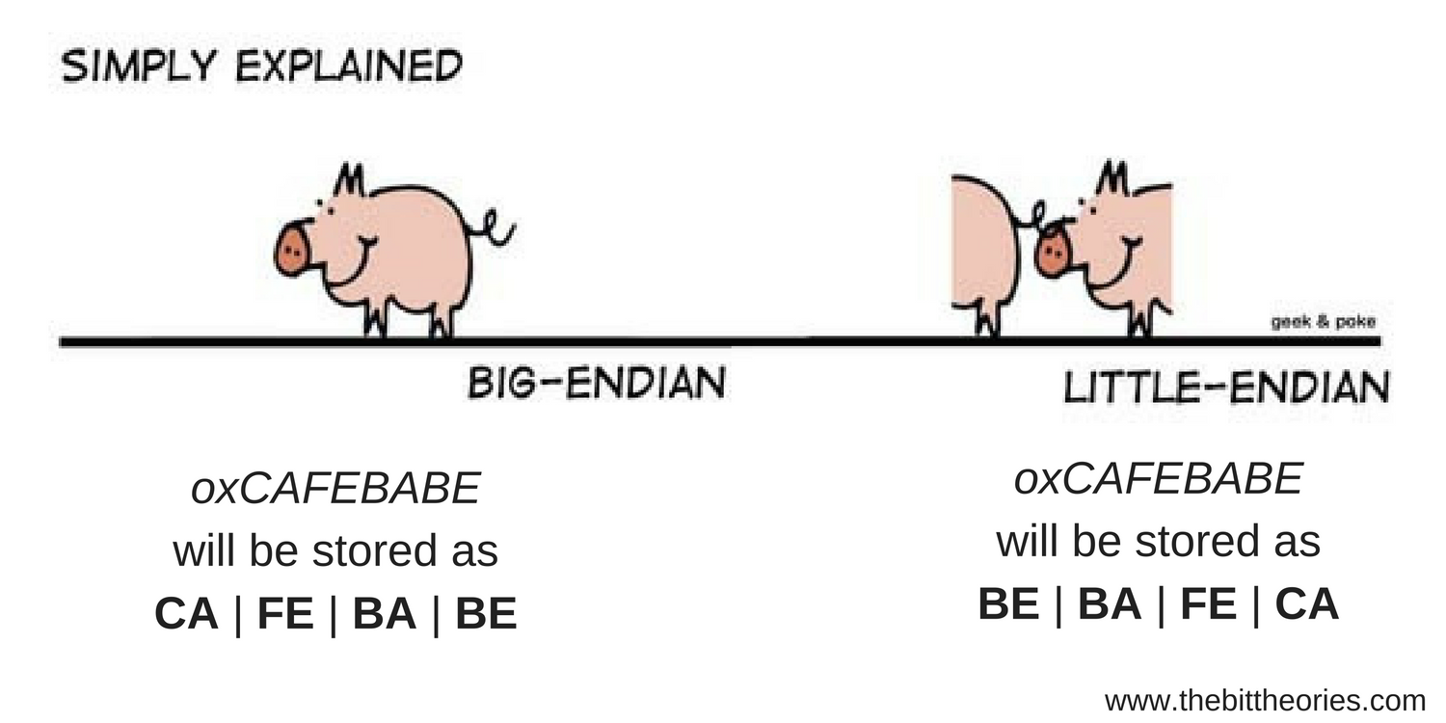
Endian

Slide 10
Endian (Network byte order)
Communication between different architectures.
Network byte order - Big Endian
Host byte order - (between Big Endian and Little Endian)
Send data to the remote, converted the host byte order to the network byte order.
Receive data from the remote, converted the network byte order to the host byte order.
Do you need to convert char data-type to network byte order?

Slide 11
File description - fd
It is a handle describing a resource, and all operations in Linux are fd.
User mode and kernel mode They are reference relationships, and kernel mode holds reference counts.
problem | reason | solution
Handle leak | Fork/Exec inherits the file handle of the parent process | Increase flag: SOCK_CLOEXEC
Data out of order | Concurrent read/write | Async && Non-Blocking
close | Decrease the reference count by one, turn off the read and write state when 0 | /
shutdown | Even if the reference count is >0, the corresponding state will be turned off. | /

Slide 12
I/O model
Synchronous && Asynchronous.
Process of performing one thing.
Blocking && Non-Blocking.
It’s base state to performing one thing
Synchronous cannot be considered blocking.
Blocking maybe considered synchronous.
Asynchronous cannot be considered Non-blocking.
Non-blocking cannot be considered Asynchronous.

Slide 13
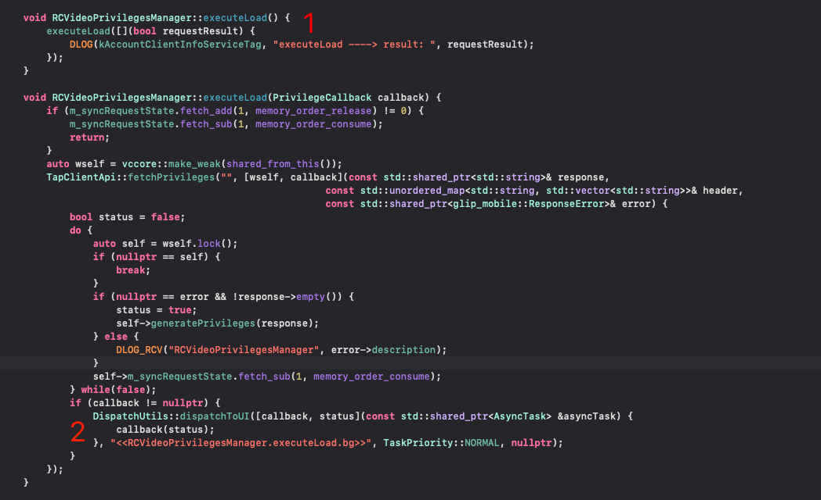
I/O model
Complete the task closure between 1 and 2.
It's async process.
Waiting response that it’s blocking and sync operations I/O.

Slide 14
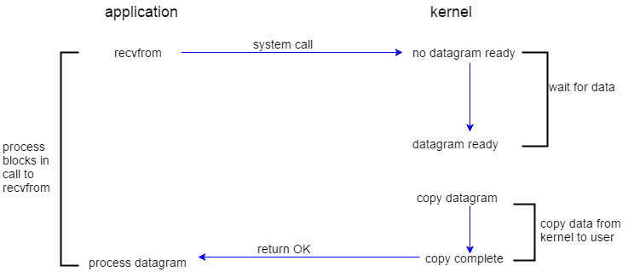
IO model(I/O operation)
Notes:
Blocking-I/O and sync I/O operations

Slide 15
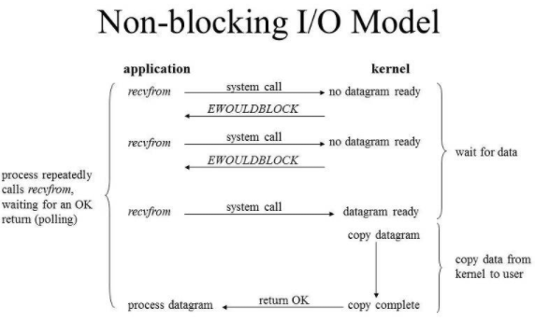
IO model(I/O operation)
Notes:
Non-Blocking I/O and sync I/O operation

Slide 16
IO model(I/O operation)
Asynchronous I/O
An asynchronous I/O operation does not cause the request process to be blocked.
At user-mode direct operated I/O data
Synchronous I/O
A synchronous I/O operation causes the requesting process to be blocked until that I/O operation completes.
At user-mode need copy I/O data to user-mode from kernel buffer.
Which ones are synchronous I/O operation and asynchronous I/O operation?

Slide 17
I/O model
I/O model | I/O Operation | How use
Blocking I/O | Synchronous - blocking | Sync call
Non-Blocking I/O | Synchronous - blocking | Loop
I/O Multiplexing | Synchronous - blocking | Loop
Signal I/O | Synchronous - blocking | /
Asynchronous I/O | Asynchronous - Non blocking | /

Slide 18
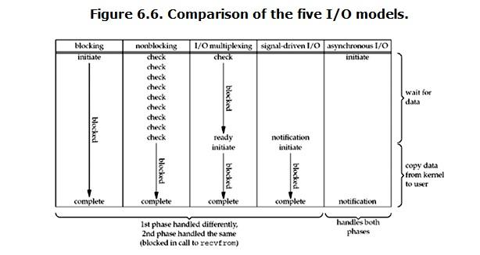
I/O model

Slide 19
I/O Multiplexing
If one or more I/O conditions are ready will notification.
Thundering herd.
File description is a reference relationship
I/O multiplexing is usually blocked mode.
Suggest
Use the non-blocking I/O in I/O multiplexing.
Avoid reusing file handles in I/O multiplexing.
Avoid data being out of order.

Slide 20
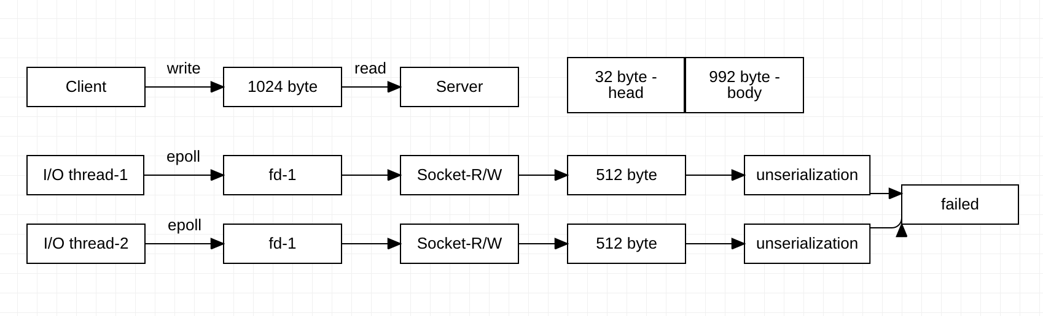
I/O Multiplexing

Slide 21
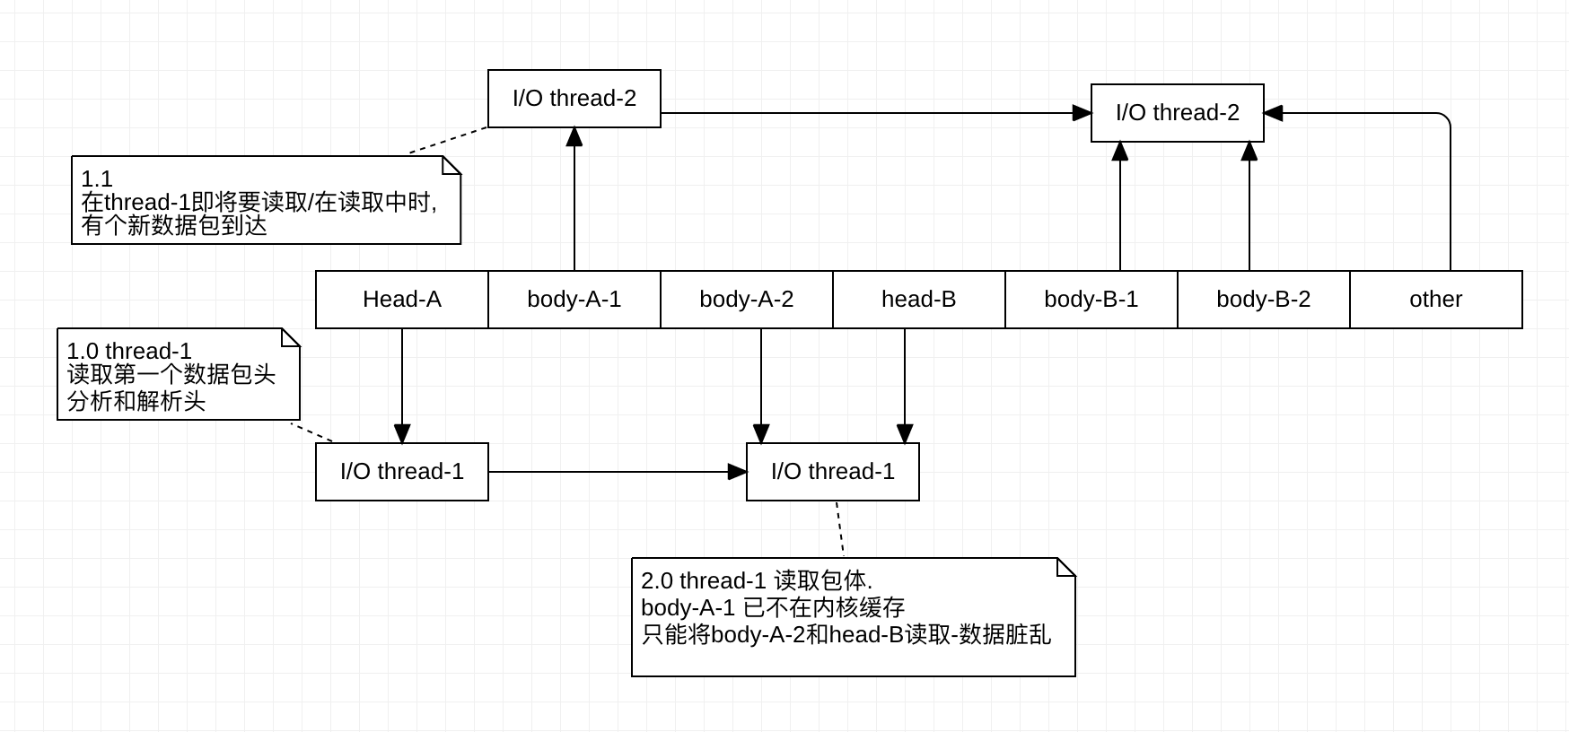
I/O Multiplexing

Slide 22
I/O Multiplexing
select - file description quantity limited.
Default number is limited to 1024.
poll - solve a problem of select, but query performance is linearly rising.
epoll - optimization query performance to poll.

Slide 23
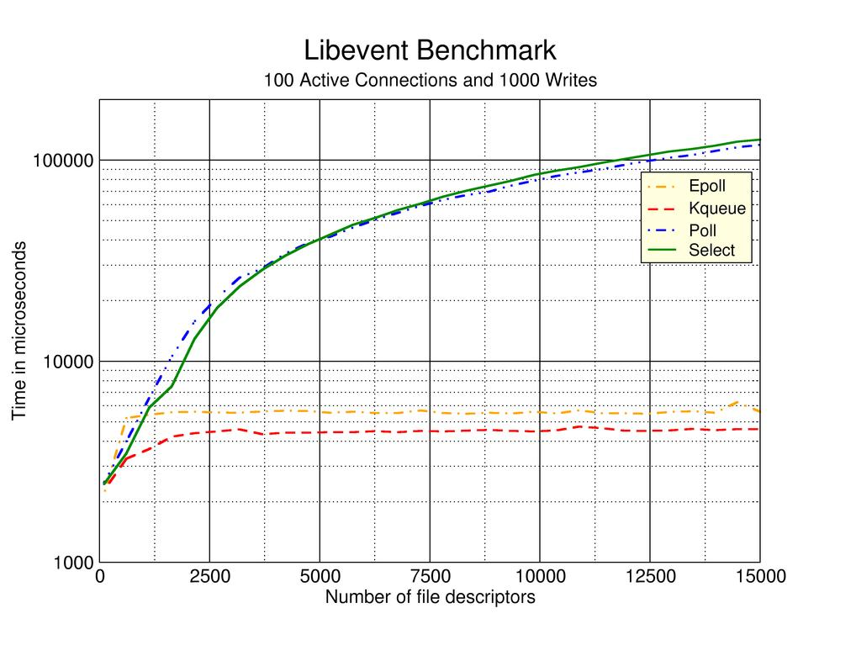
I/O Multiplexing

Slide 24
Epoll
ET
A notice
LT
Always notify until processing is complete.
EPOLLONESHOT
Notification completes deletion of registration from epoll
EPOLLEXCLUSIVE
Make sure that only one epoll is woken up in the shared fd.
Solve thundering herd problem?

Slide 25
Reactor - (ET/LT)
Main
Reactor
Accept
Dispatch
Child
Reactor
Child
Reactor
Child
Reactor
Client
Client
Read/Write
Read/Write
Read/Write
Client
I/O thread
I/O thread
I/O thread
work thread
work thread
work thread

Slide 26
Reactor - (ET/LT) + EPOLLONESHOT
Main
Reactor
Accept
Child
Reactor
Client
Dispatch
Client
Work thread
Work thread
Work thread
Client
Reactor

Slide 27
Epoll
epoll_create
epoll_wait
epoll_ctl
Thread safety issue
This thread safe, but old version has bug(prevent missed events)
thundering herd problem
Notes:
https://lore.kernel.org/patchwork/patch/351273/

Slide 28
Epoll
Suggest
Disable shared fd.
If you mix different flags, you must consider the end result of their interaction.
Solve these problems through engineering design
Thundering herd problem
Multi thread R/W the same fd.
Notes:
https://lore.kernel.org/patchwork/patch/351273/

Slide 29
Reactor
Kernel
Dispatch
Client
Client
Child
Reactor
Child
Reactor
Child
Reactor
Client
A/R/W
A/R/W
A/R/W
I/O thread
I/O thread
I/O thread
work thread
work thread
work thread

Slide 30
Reactor
Kernel
Dispatch
Child
Reactor
Client
A/R/W
Client
coroutine
queue
Client
I/O thread
coroutine
queue
I/O thread
coroutine
queue

Slide 31
Q&A

